Slide 1
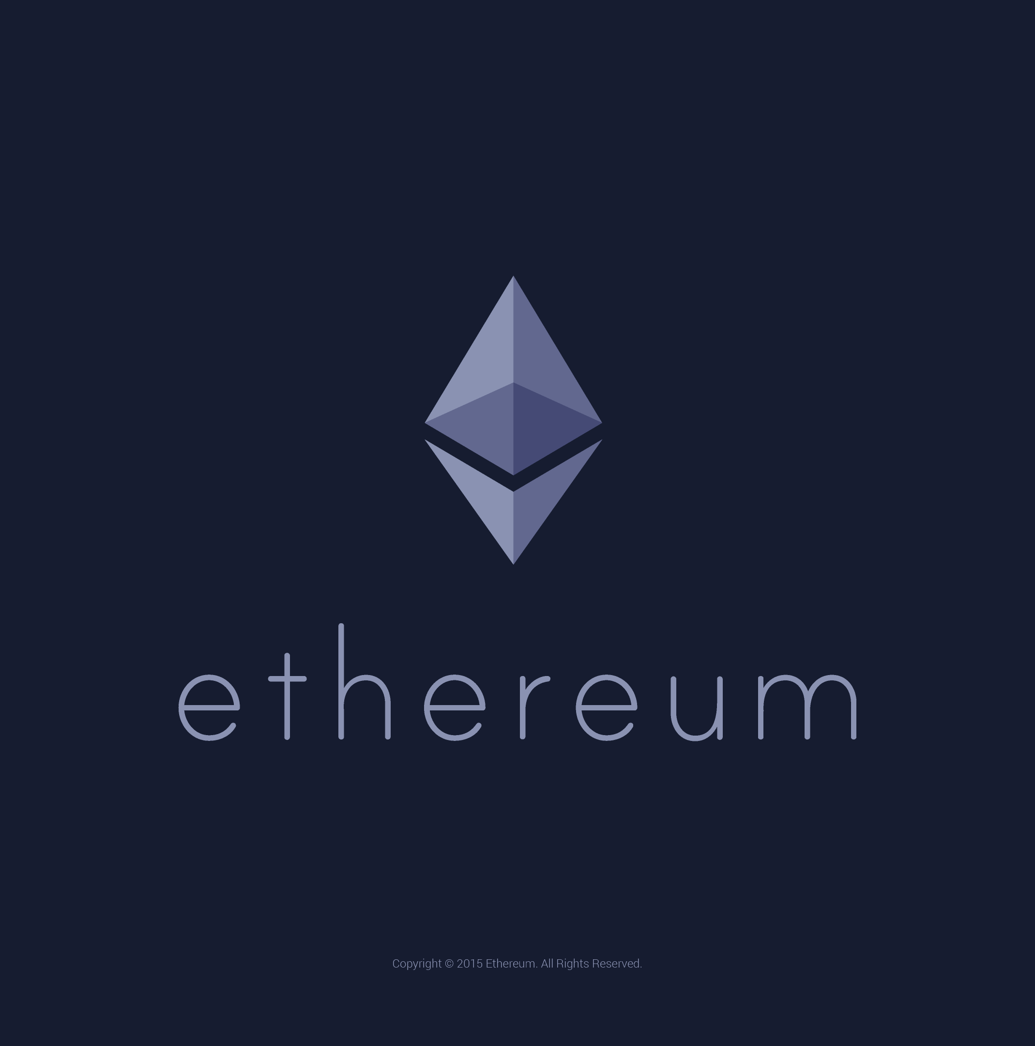

Blockchain Wallet
By- Omee Verma
Enrollment No: 0101CA201021
Branch: MCA

Slide 2
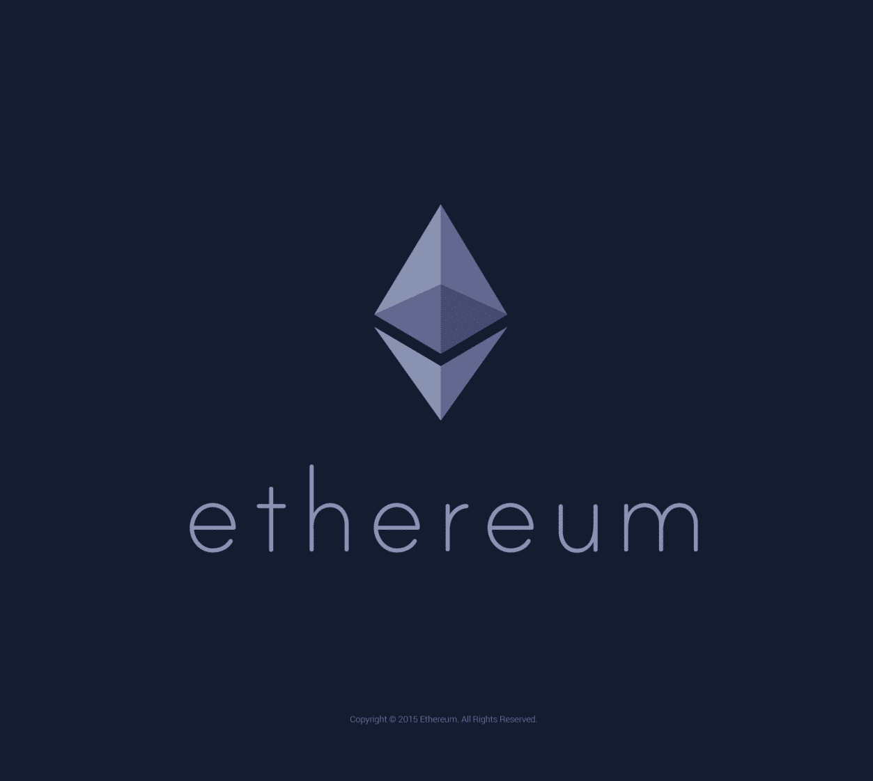

Introduction

Slide 3
Agenda
Brief Introduction to Blockchain
Objectives & Benefits of Blockchains
Workflow
Software Components
Future Scope

Slide 4

Brief Introduction to Blockchain
A Blockchain is a distributed database that is shared among the nodes of a computer network. As a database, a blockchain stores information electronically in digital format. Blockchains are best known for their crucial role in cryptocurrency systems, such as Bitcoin.
A Cryptocurrency is a digital or virtual currency that is secured by cryptography, which makes it nearly impossible to counterfeit or double-spend. Many cryptocurrencies are decentralized networks based on blockchain technology—a distributed ledger enforced by a disparate network of computers.

Slide 5
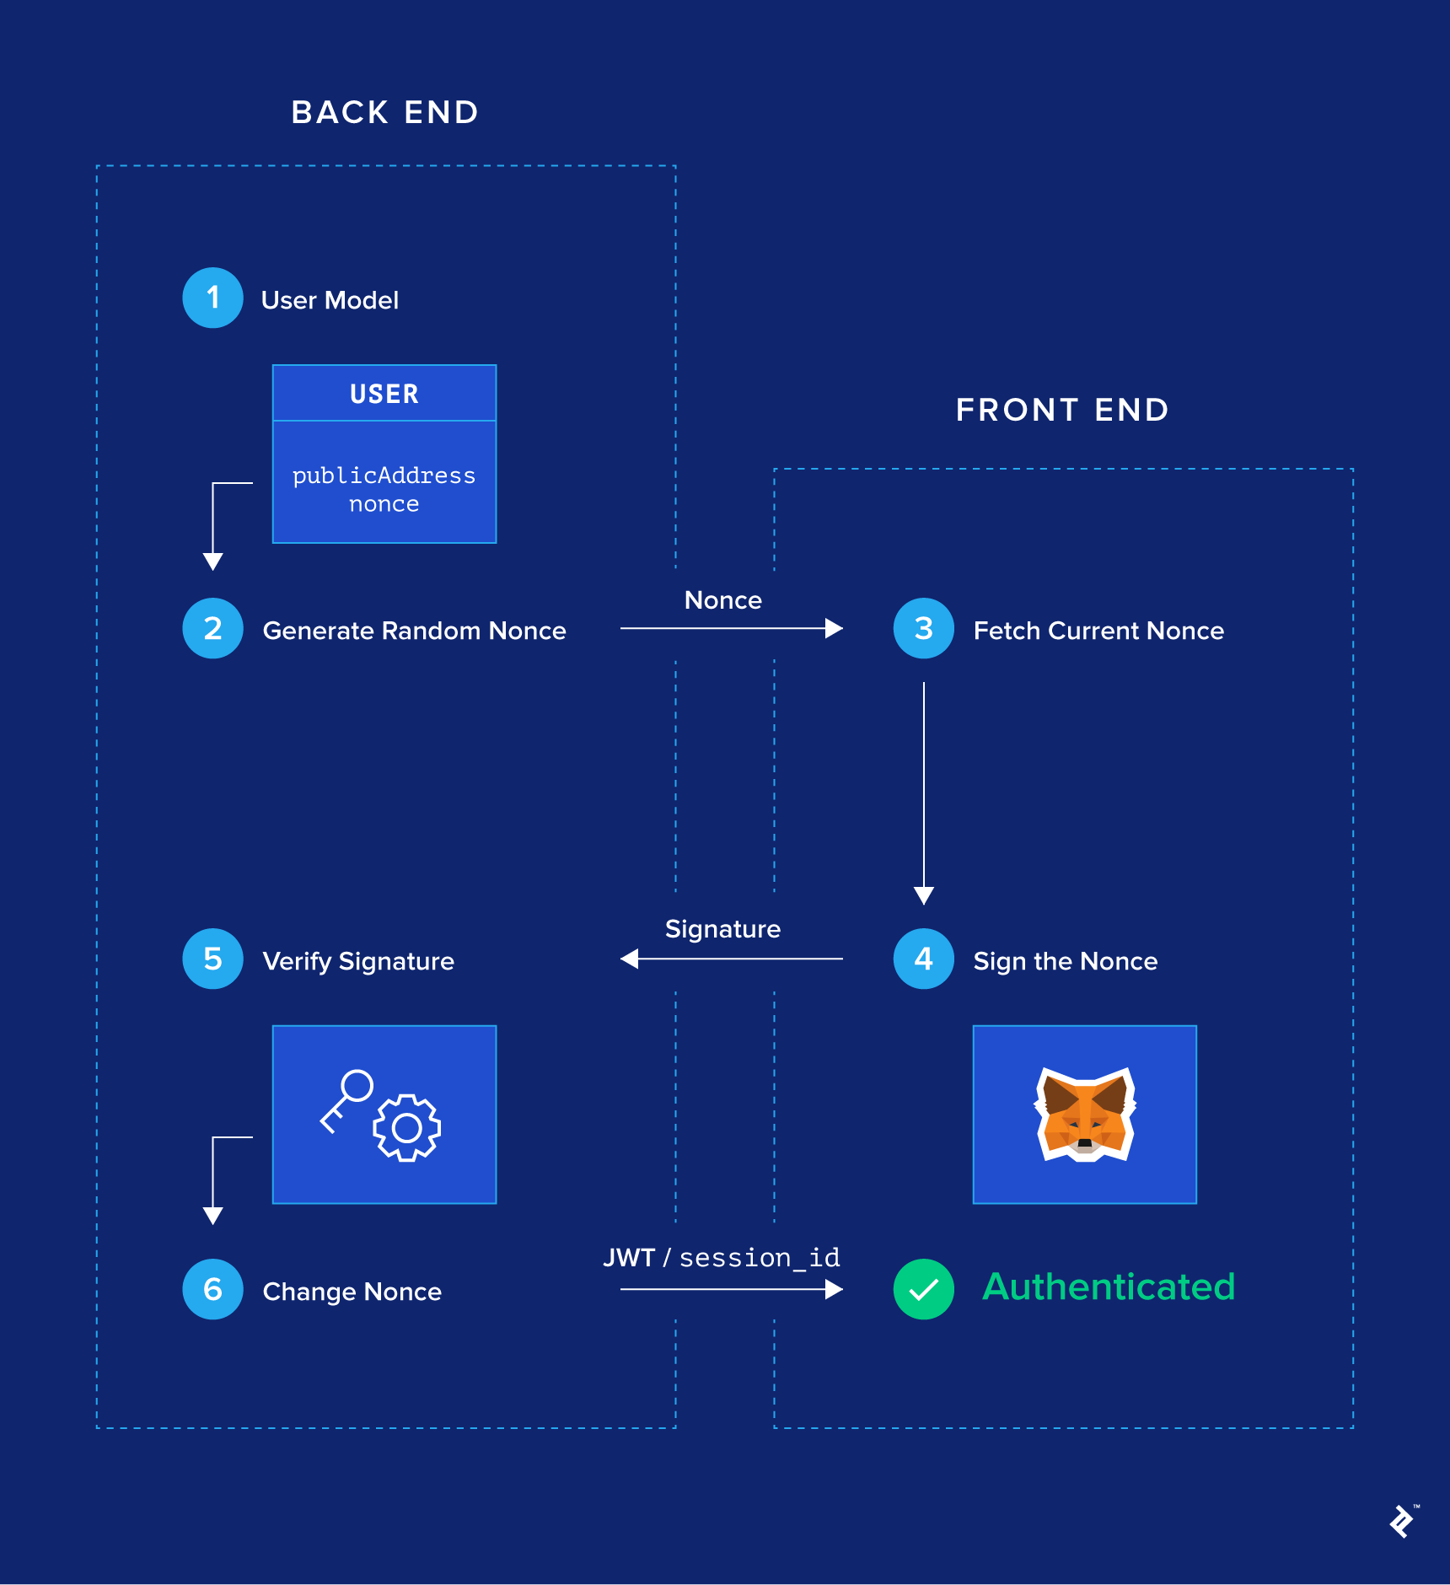
Workflow

Slide 6
Objectives & Benefits of Blockchain
The goal of blockchain is to allow digital information to be recorded and distributed, but not edited.
Accuracy of the Chain
2) Cost Reductions
3) Private & Secure Transaction

Slide 7
Objectives & Benefits of Blockchain
1) Enhanced Security: Your data is sensitive and crucial, and blockchain can significantly change how your critical information is viewed.
2) Greater Transparency: Without blockchain, each organization has to keep a separate database. Because blockchain uses a distributed ledger, transactions and data are recorded identically in multiple locations.
3) Increased efficiency and speed: Traditional paper-heavy processes are time-consuming, prone to human error, and often requires third-party mediation. By streamlining these processes with blockchain, transactions can be completed faster and more efficiently.

Slide 8
Software Components
Metamask
Remix Ethereum
Andersbrownworth Blockchain
Visual Studio Code
Solidity 0.6.0

Slide 9
Future Scope
By 2030, it could be used as a foundational technology for 30 per cent of the global customer base. By 2025, blockchain would add a business value that will grow to over $176 billion.
Traditional paper-heavy processes are time-consuming, prone to human error, and often requires third-party mediation.
By streamlining these processes with blockchain, transactions can be completed faster and more efficiently.

Slide 10
Thank You☺

